Slide 1
Green Schools Guide
The Central Coast Green Building Council
Green Schools Committee

Slide 2
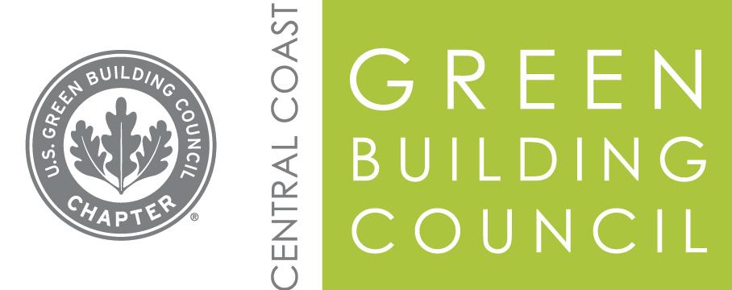
Who are we?
The mission of the Central Coast Green Building Council:
“To make sustainable communities available to everyone within this generation.”
Through the Gateway to Green Schools program the Central Coast Green Building Council and its partners provide a number of sustainability resources to local K-12 schools.
Developing a sustainability plan
Reducing environmental impact and costs
Improving the health and wellness of schools, students, and staff
Providing effective environmental education

Slide 3
What is a Green School?
A school or building facility that creates a healthy environment that is conducive to learning while saving energy, resources, and money.
A green school demonstrates excellence in the 3 pillars outlined by the US Department of Education Green Ribbon Schools program.
Pillar 1: Reduce environmental impact and cost
Pillar 2: Health and wellness
Pillar 3: Environmental Education

Slide 4
What can Gateway to Green Schools do for your school?
There are several levels of participation a school can enroll in
Establish a Green Schools Baseline
Receive a $500 grant to fund a Green Schools Project
Develop a Green Schools Action Plan
Become a Green Ribbon School
Celebrate your project on Green Apple Day of Service!

Slide 5
1. Establish a Green Schools Baseline
Complete a basic survey to asses your schools current standing according to braid list of sustainability criteria.
This survey captures your schools current sustainability efforts
The survey is a simplified short form of the Green Ribbon Schools application.
The survey acts as part of the application for the $500 grant
Provides a springboard to work toward the Green Ribbon Schools Application
Identifies areas to celebrate as well as ways to improve

Slide 6
2. Receive $500 grant to fund a Green Schools project
Complete the baseline survey
Submit a sustainability project interest form
Must be used towards a sustainability related project
Get the students involved in picking a project
Grants are given in order of paperwork received
Funds are limited so apply early!
Contact us for inspiring project ideas or visit mygreenapple.org

Slide 7
3. Develop a Green Schools Action Plan
Members of the Green Schools Committee/Gateway Coordinator can assist your school develop a sustainability plan based on the information provided by the survey.
Steps may include:
Create a Green Team with the power to act!
Adopt an Environmental Vision Statement
Conduct a comprehensive School Environmental Audit (Energy, Water, Waste)
Integrate Environmental Education into curriculum
Identify partners, programs, and strategies for advancing sustainability
Monitor and evaluate progress

Slide 8
4. Become a Green Ribbon School
Gateway coordinator can assist your school through the California Green Ribbon Schools Award process.
Schools with a score of 55% or higher will receive a State level award
The California Department of Education nominates the 5 highest scoring schools for the national green ribbon award. These schools are called “Green Achievers”
Schools can apply every year for the Green Ribbon Schools Award until they are awarded at the National level.
Reasons to apply
National and State Recognition
Celebrate Achievements
Invite New Partnerships
Share Best Practices
Build School Culture

Slide 9
3 Pillars of the Green Ribbon Schools Pillar I: Resources
Reduce environmental impacts and costs
Conserve Energy, Save Water, and Reduce Waste
Gateway will provide surveys to guide the collection of information
Support school audits (ideally performed by students)
Assist with connecting with the district facilities department (when needed)

Slide 10
Pillar II: Health
Captures the health and wellness of students and staff
Physical activity and nutrition
Environmental health
Indoor environmental quality
Assistance with curriculum, programs, and connections with local non-profits to develop:
School gardens
Promote physical activity
Outdoor learning and classroom space

Slide 11
Pillar III: Education
Provide multi-disciplinary environmental education
Using STEM
Correlation to State Standards
Civic Skills
Green Career pathways
Some partners include the Cuesta Sustainability Resource Center, One Cool Earth, and the CREEC Network. Non-profits that provide free environmental and energy related curriculum.
CSRC offers professional development to address this pillar.

Slide 12
Celebration
Monterey Road Elementary School of Atascadero received a 2015-2016 California Green Ribbon School Silver Award.
Bishops Peak Elementary and Oceano Elementary completed the 2015-2016 Green Ribbon Applications.

Slide 13
Green Apple Day of Service
“Green Apple is a global movement to put all children in schools where they can have clean and healthy air to breathe, where energy and resources are conserved, and where they can be inspired to dream of a brighter future”
Hold a service event to celebrate the progress and impact of your project on Green Apple Day of Service.
Register your event at mygreenapple.org
The website has many links to inspire your school to choose a project
Green Apple Day of Service is a program of the Center for Green Schools and the United States Green Building Council
When is it? September 2016?

Slide 14
Big Picture
20% of America goes to school every day. Too many of these students and teachers attend schools that are inefficient and miss important opportunities to reduce operational costs, foster learning and protect student health.
By promoting the greening of all schools—new or existing– we can make a tremendous impact on student and staff health, test scores, teacher retention, school operational costs and the environment.
Let us help guide your school though the varying levels of green schools participation.
We will help develop short and long term plans to put your school on the path to earning the most ambitious accolades in the a national certification as a Green Ribbon School.

Slide 15
Other Programs
The Mayor’s Alliance for Green Schools

